Slide 1

WELCOME

Slide 2
BackStop “Desktop Application”
Course Name :Application Development Sessional
Course Code :CSE-252

Slide 3
Supervisor :
Md. Nahid Sultan
Assistant Professor
Dept. of Computer Science and Engineering
Presented by :
Mrinal Basak Shuvo (2002064)
Adity Barua (2002014)
Arjon Talukder ( 2002022)

Slide 4
The contribution of the organizations in a university :
1. Development of Good Characteristics:
Leadership Skills
Communication Skills
Time Management
Collaboration and Teamwork
Problem-Solving
Adaptability
2. Career Advancement
Networking:
Skill Development
Practical Experience
Demonstrating Initiative
Exposure to Industry Trends
Soft Skills

Slide 5
Type Of Organizations
Educational And Guideline
Organization
Volunteer
Organization
Cultural
Organization

Slide 6
What BackStop Does?
Providing an integrated platform for the existing organizations in HSTU and building an online community for providing the solutions and guidelines so that it could reach more and more students and work for their welfares.

Slide 7
Necessity of BackStop:
BackStop basically focusses on the promotion of the organizations of HSTU. Educational, cultural, and volunteer organizations within a university play a significant role in helping students develop good characteristics and enhancing their career prospects.
BackStop has been designed to provide an easy way for students to have access to the information that couldn’t reach to them for lacking technological facilities and proper promotion.

Slide 8
Project “BackStop” Objective :
To provide the contact numbers of the core members of the organization so that students can contact for further information.
Provides official E-mail ID of the organization where students can add their comments, suggestions and complaints.
To provide the information about the existing organizations of HSTU so that students can show interest joining them based on their needs and interests.
Enables the students to download a registration form and join that organization

Slide 9



Tools And Technology
NetBeans
Java
Java
Swing

Slide 10
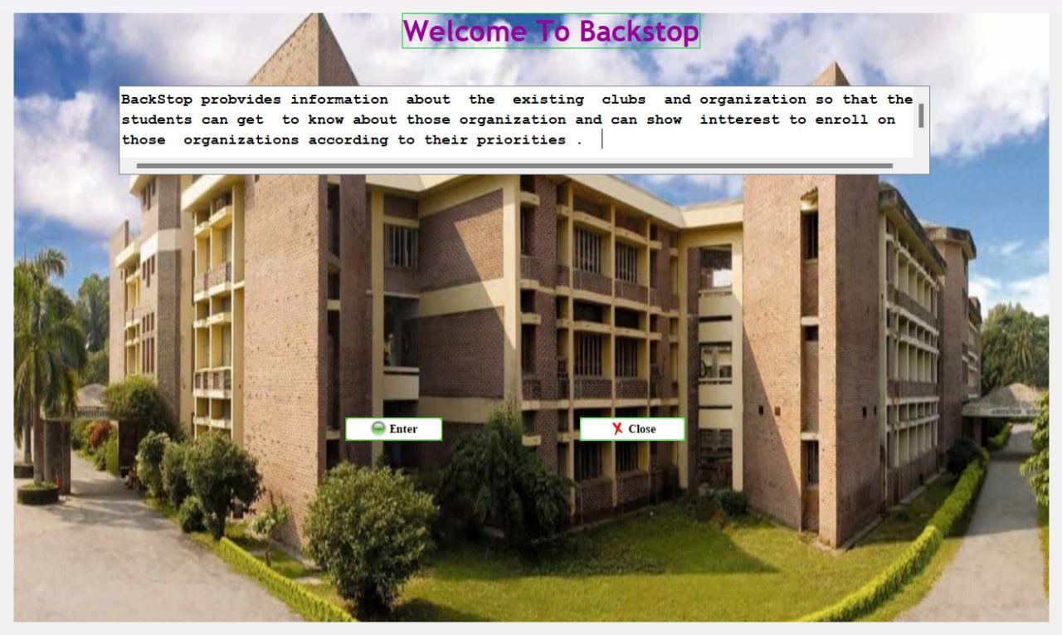
Home page

Slide 11

Category of Organizations

Slide 12
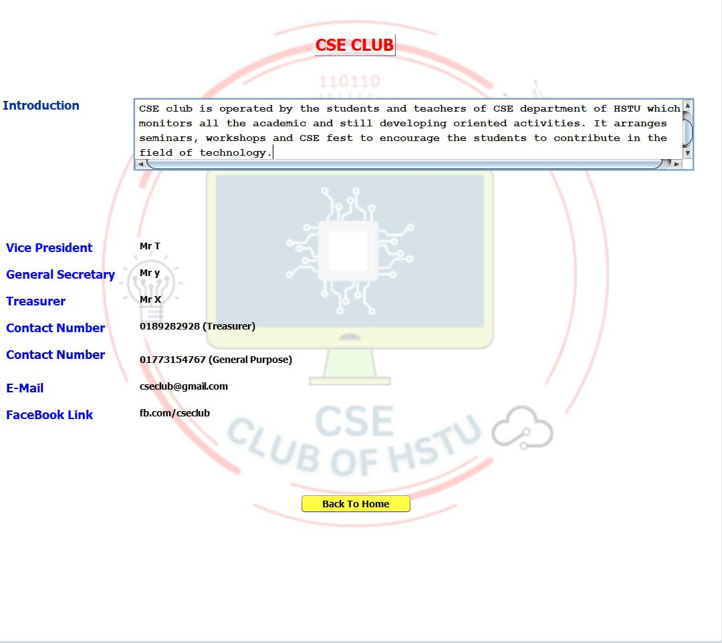
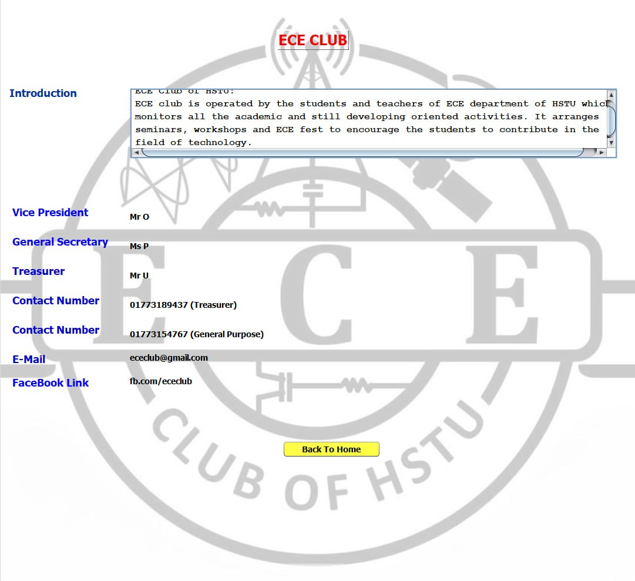

Slide 13
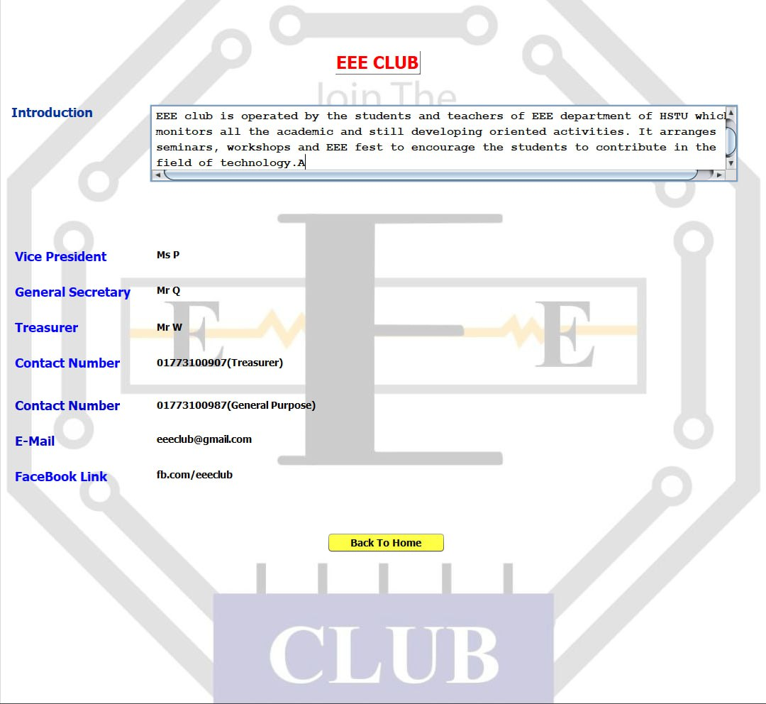
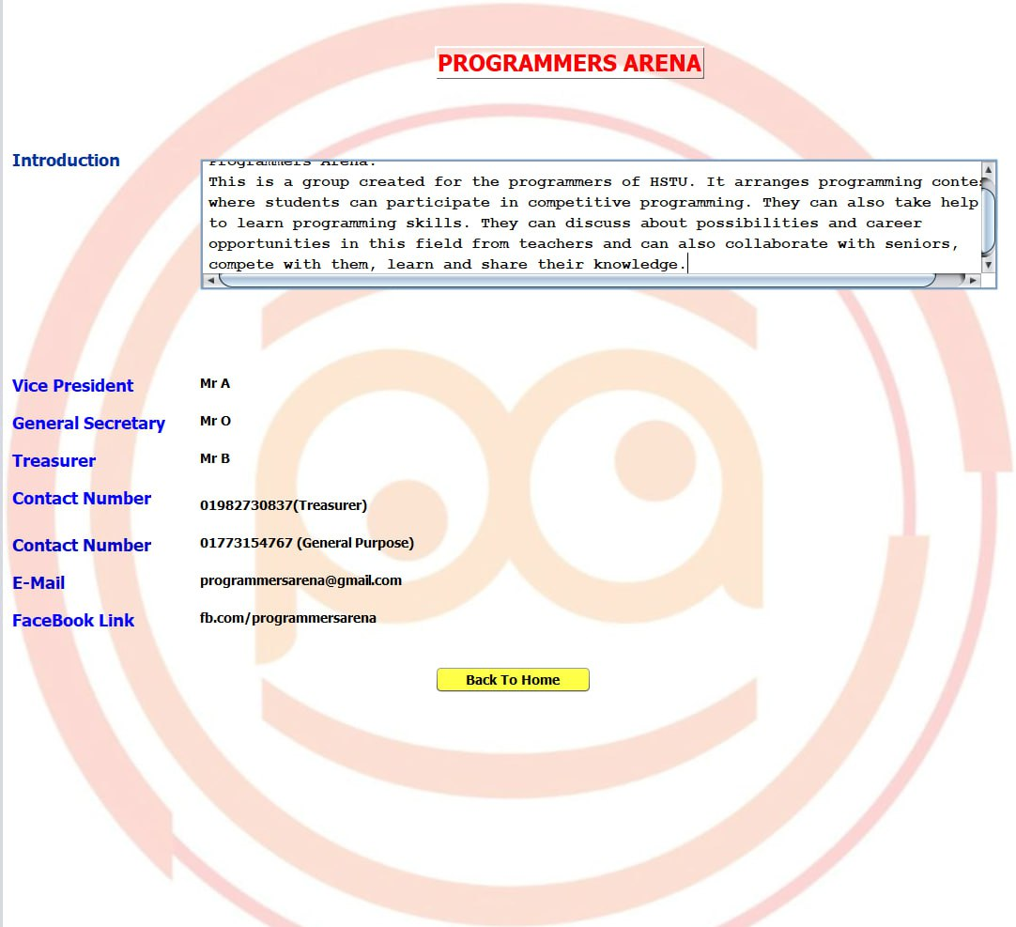

Slide 14
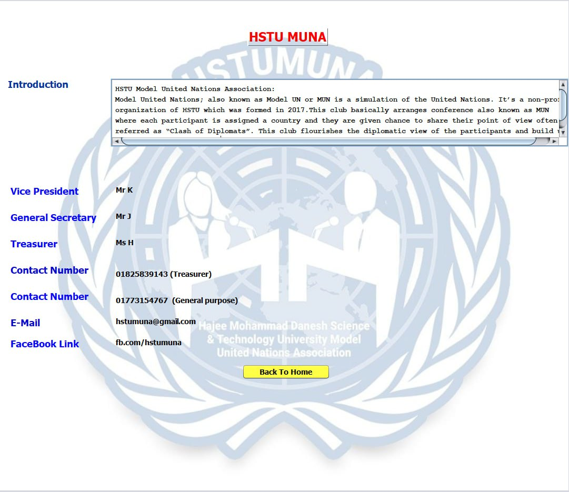
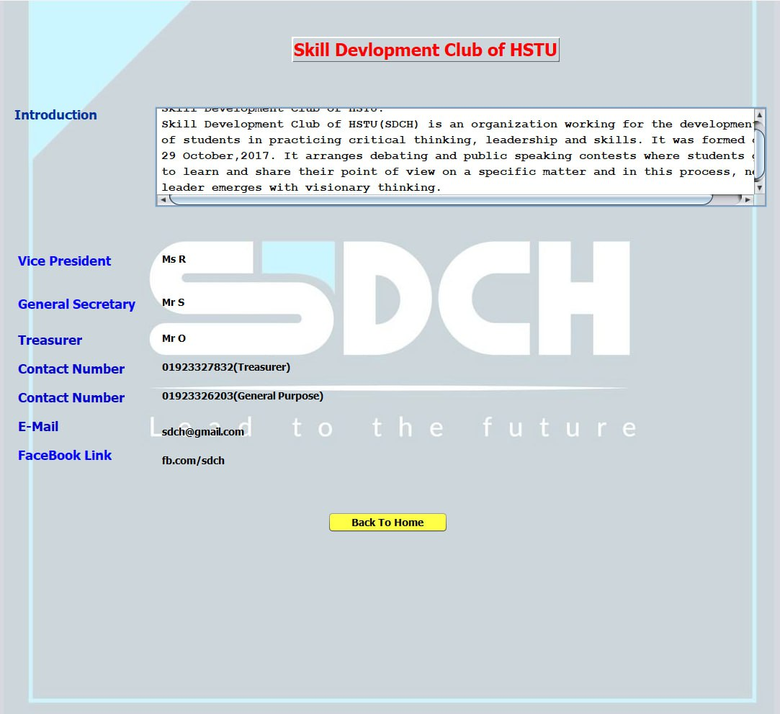

Slide 15
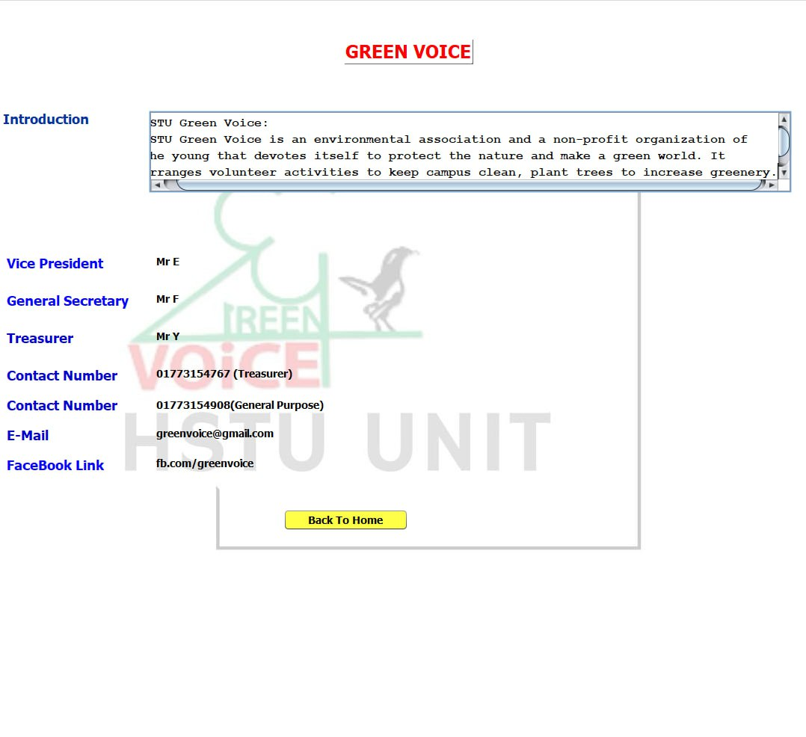
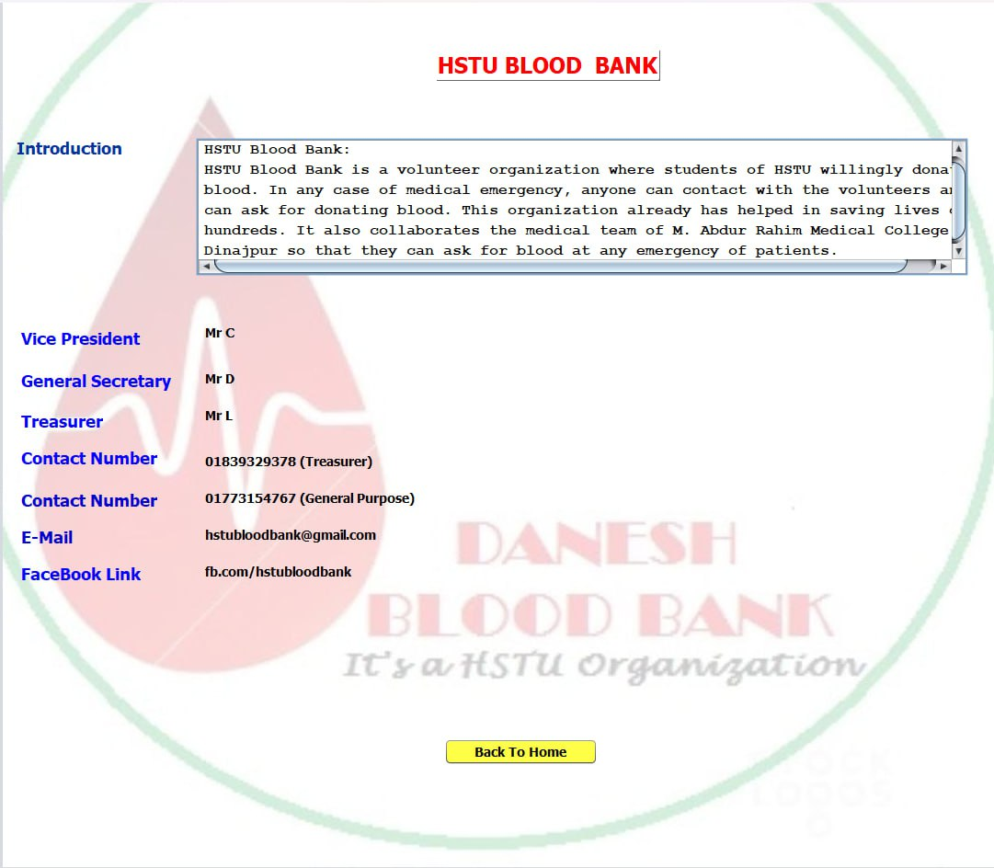

Slide 16
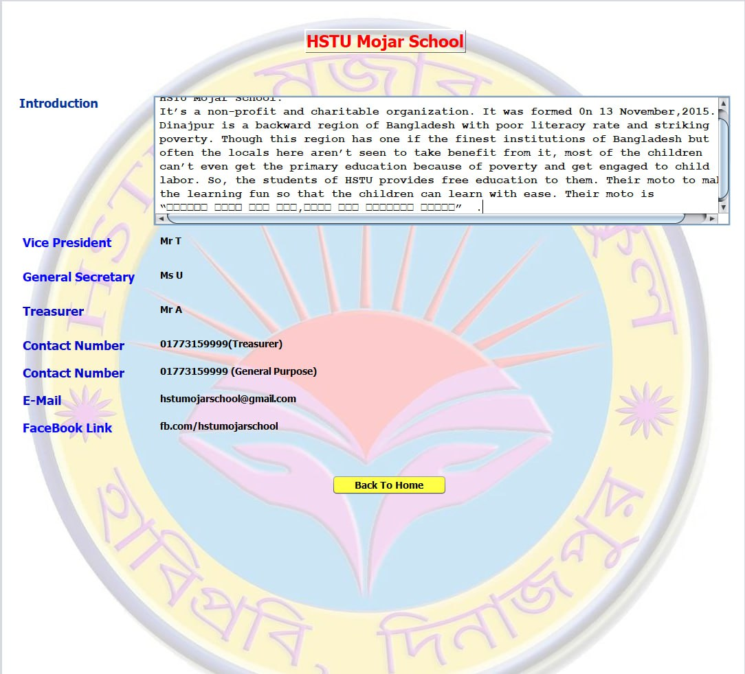
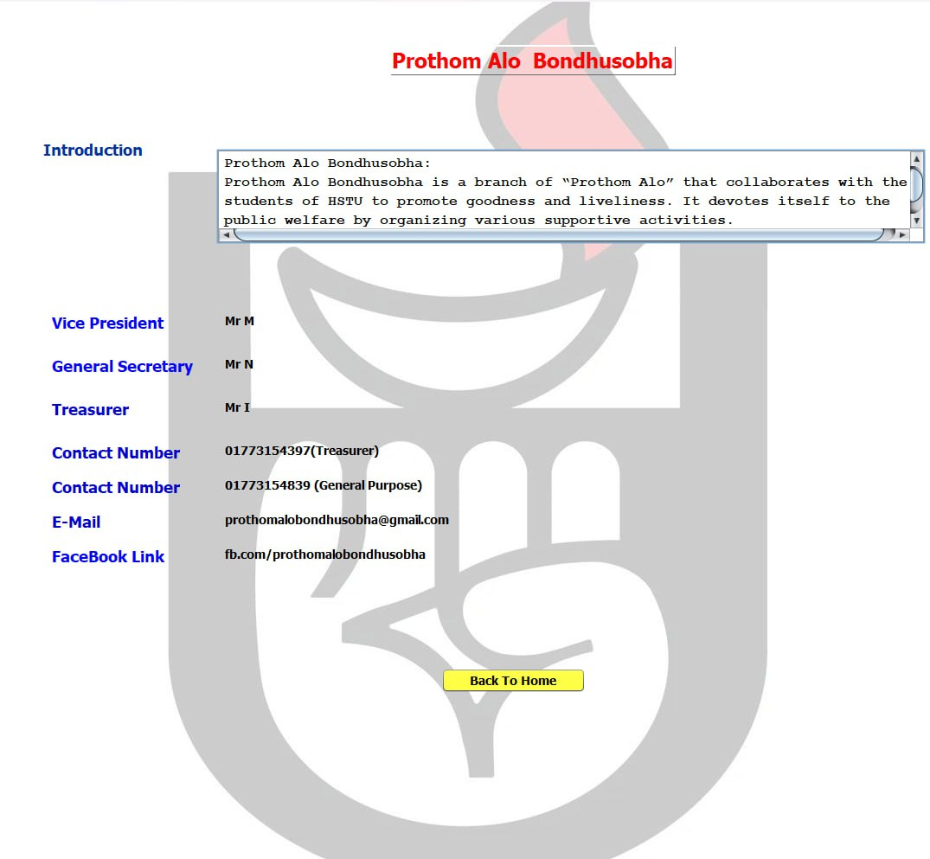

Slide 17
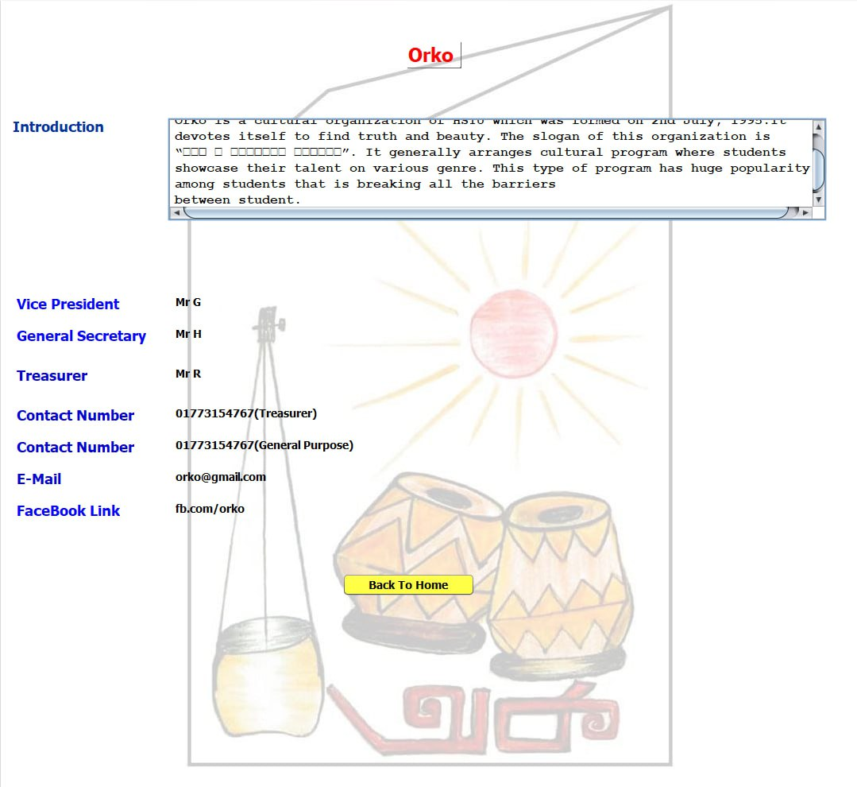
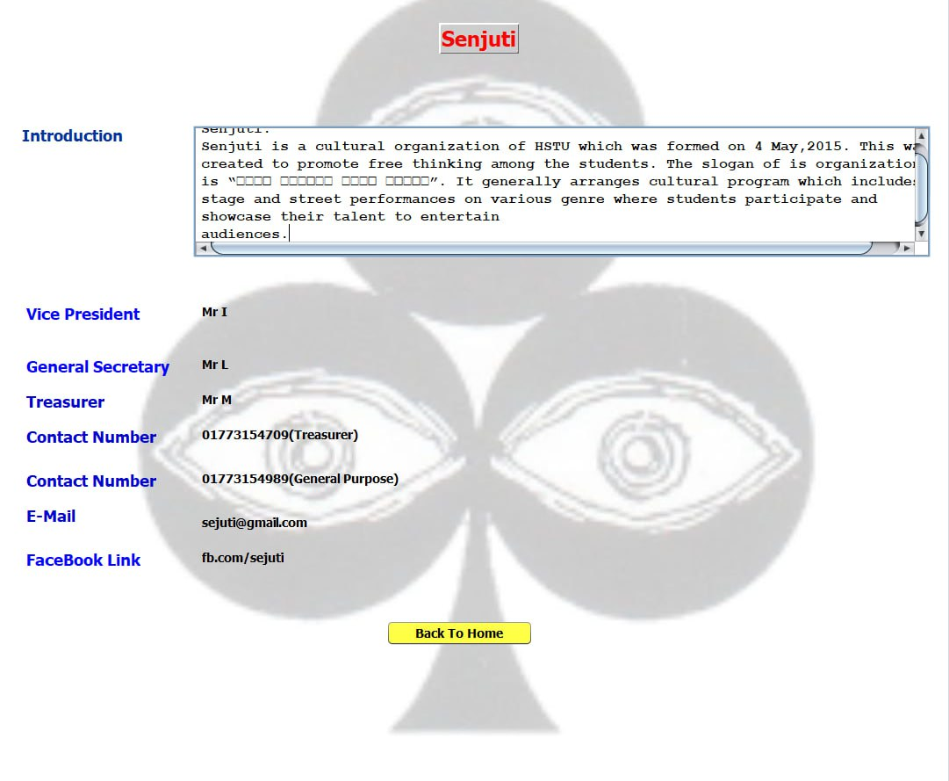

Slide 18
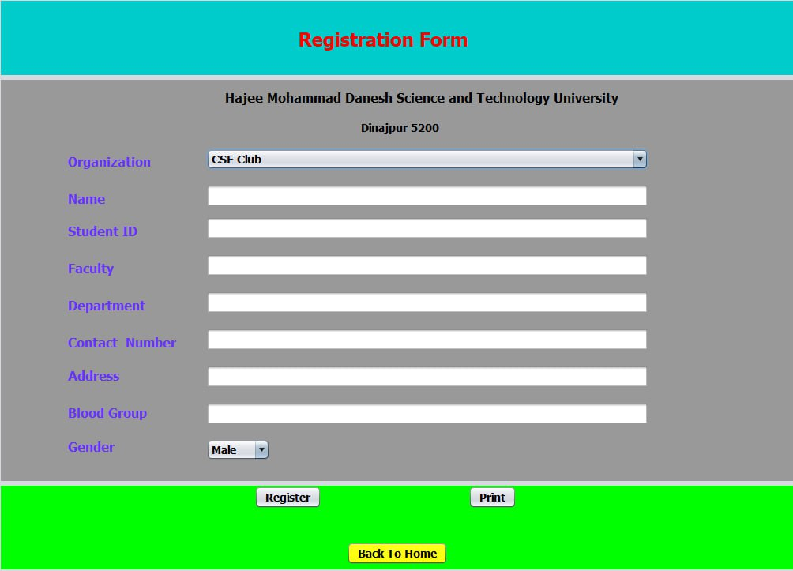
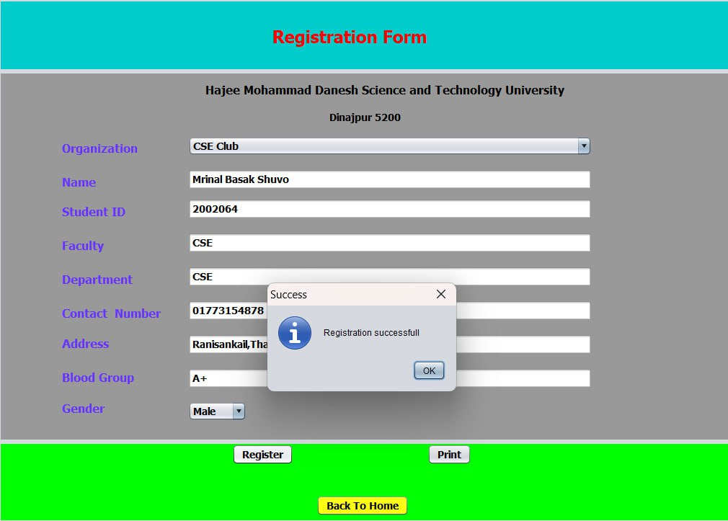

Slide 19
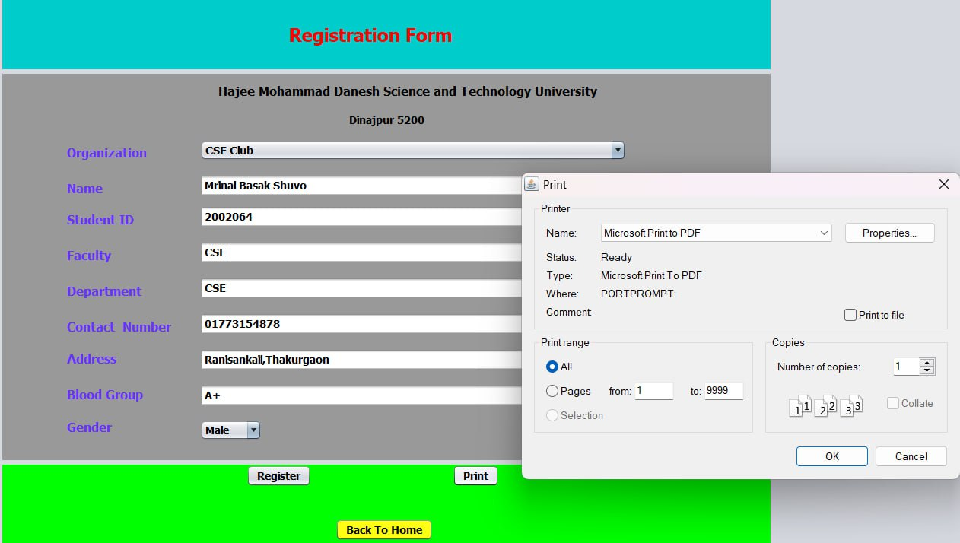

Slide 20
Future plan of backstop :
Adding database so that the university can store the information of the applicants and can contact with them as per need, e.g., “HSTU Blood bank” can directly contact with the volunteers in emergency and also filter the possible donors by seeing if they have already given blood in the last few months.
Adding features so that students can directly apply to an organization as per their interest rather than being physically present to be registered.
Organizations can place any notice for their upcoming activity so that students can have the knowledge about it.

Slide 21
Scope and Limitation of this project:
BackStop has been designed to provide an easy way for students to have access to the information that couldn’t reach to them for lacking technological facilities and proper promotion. However, this project is facing some obstacles which is repressing it achieving of its goals, like lacking of skills in us to make this project more practical as we just tried to make a graphical user interface by using only the means that we are taught till now. Though we’ve plans to add Database like features to store the information of the students so that the organizers can contact them as per need and also create a complete platform to make it a complete media to interact. Another challenge is to introduce it among the students. For this collaboration among the students and teachers can make it happen and can be represented it with other official facilities.

Slide 22
Conclusion of the project:
In this project, we developed an interface between the organizations and the students to collaborate effectively without any lengthy process. For any complaint, recommendation or anything they can directly contact with the control panel. It provides an easier way to access . University, in this process truly become a training warehouse by providing the students many facilities to make them capable for the competitive world.

Slide 23
Reference:
https://www.wikipedia.org/
https://www.youtube.com/playlist?list=PLgH5QX0i9K3rAHKr6IteF5kdgN6BorH9l
https://netbeans.apache.org/
https://www.oracle.com/tools/technologies/netbeans-ide.html
https://www.facebook.com/
https://www.google.com/
Introduction to Java Programming by Y. Daniel Liang

Slide 24
THANK YOU

